Slide 1

Summary / Planning / Presentation
Search IT job in China
Member：Long Jin
Member ：Wenda Li
Advisor：Pathathai Na Lumpoon

Slide 2

CONTENTS
1
Introduction Project
2
Progress 1
3
Progress 1 difficulties
print the presentation and make it into a film a wider field
4
Progress 2 plan
print the presentation and make it into a film a wider field

Slide 3
PART 01
Introduction Project

Slide 4
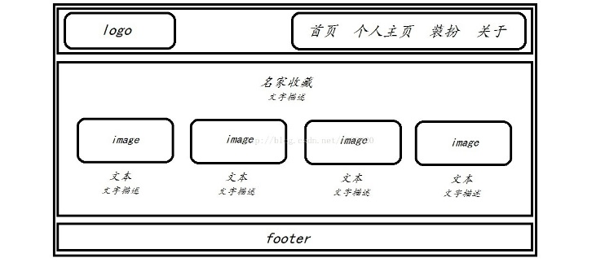
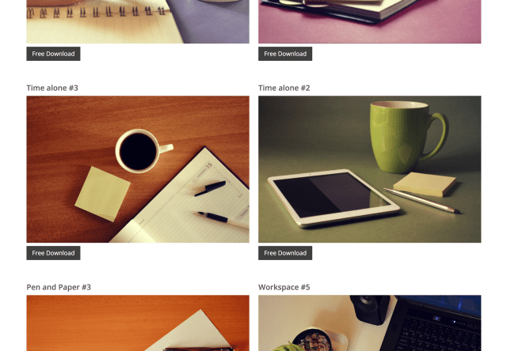
Introduction Project
What is this
Website
use
The user can demonstrate on a projector or computer, or presentation and make it film to be used in a wider field
The user can demonstrate on a projector or computer, or presentation and make it film to be used in a wider field

Slide 5


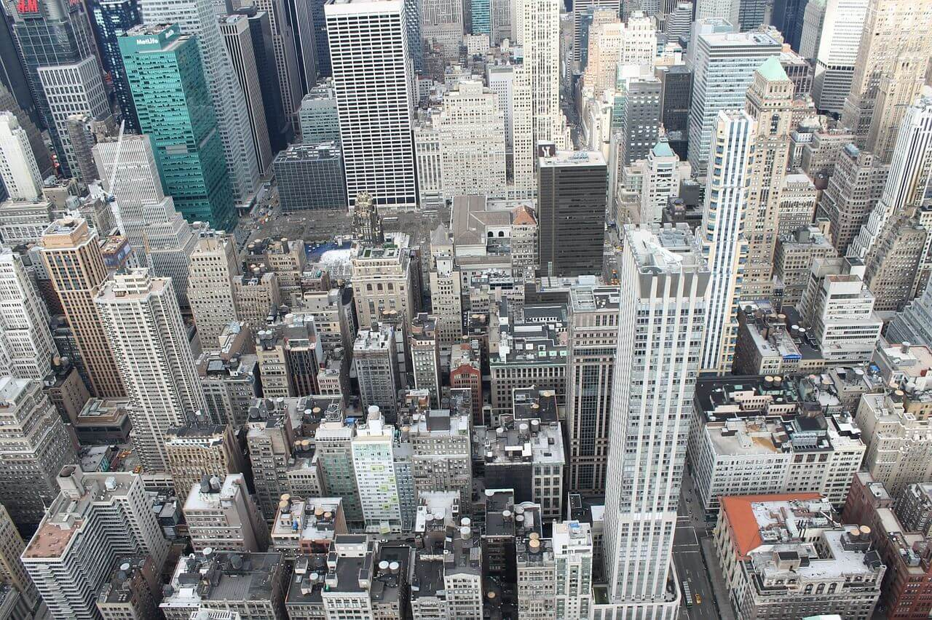

Introduction Project
Type of user:
Search Job website
Job seeker
The user can demonstrate on a projector or computer, or presentation and make it film to be used in a wider field
The user can demonstrate on a projector or computer, or presentation and make it film to be used in a wider field
Company
Admin
The user can demonstrate on a projector or computer, or presentation and make it film to be used in a wider field
The user can demonstrate on a projector or computer, or presentation and make it film to be used in a wider field

Slide 6
Introduction Project
01
Vue.js
Node.js
01
PhpMyAdmin
The user can demonstrate on a projector or computer
The user can demonstrate on a projector or computer
The user can demonstrate on a projector or computer, or presentation and make it film to be used in a wider field
02
标题文字添加
02
标题文字添加
The user can demonstrate on a projector or computer
The user can demonstrate on a projector or computer
标题文字添加
03
标题文字添加
The user can demonstrate on a projector or computer, or presentation and make it film to be used in a wider field
03
标题文字添加
The user can demonstrate on a projector or computer
The user can demonstrate on a projector or computer

Slide 7
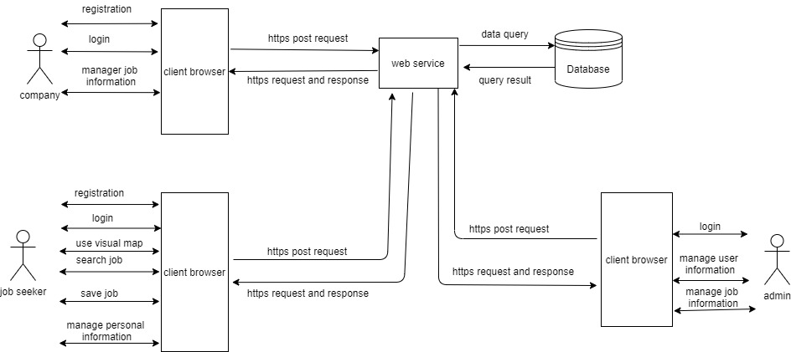
年度工作概述
print the presentation and make it into a film to be used in a wider field
Structure

Slide 8
Introduction Project
Total features
标题文字添加
标题文字添加
print the presentation and make it film to be used in a wider field
print the presentation and make it film to be used in a wider field
标题文字添加
标题文字添加
print the presentation and make it film to be used in a wider field
print the presentation and make it film to be used in a wider field
标题文字添加
标题文字添加
print the presentation and make it film to be used in a wider field
print the presentation and make it film to be used in a wider field

Slide 9
年度工作概述
print the presentation and make it into a film to be used in a wider field
Proposal
Progress 1
Progress 2
Show Progress
Final Progress
presentation and make it film to be wider field
presentation and make it film to be wider field
presentation and make it film to be wider field
presentation and make it film to be wider field
presentation and make it film to be wider field

Slide 10
年度工作概述
print the presentation and make it into a film to be used in a wider field
Limitation
标题文字添加
标题文字添加
presentation and make it film to be used in a wider field
presentation and make it film to be used in a wider field
标题文字添加
标题文字添加
presentation and make it film to be used in a wider field
presentation and make it film to be used in a wider field

Slide 11
PART 02
工作完成情况
The user can demonstrate on a projector or computer, or print the presentation and make it into a film to be used in a wider field

Slide 12
年度工作概述
print the presentation and make it into a film to be used in a wider field
标题文字添加
标题文字添加
presentation and make it film to be used in a wider field
presentation and make it film to be used in a wider field
标题文字添加
标题文字添加
presentation and make it film to be used in a wider field
presentation and make it film to be used in a wider field

Slide 13
工作完成情况
print the presentation and make it into a film to be used in a wider field
标题文字添加
标题文字添加
print the presentation and make it film to be used in a wider field
print the presentation and make it film to be used in a wider field
标题文字添加
标题文字添加
print the presentation and make it film to be used in a wider field
print the presentation and make it film to be used in a wider field
标题文字添加
标题文字添加
print the presentation and make it film to be used in a wider field
print the presentation and make it film to be used in a wider field

Slide 14
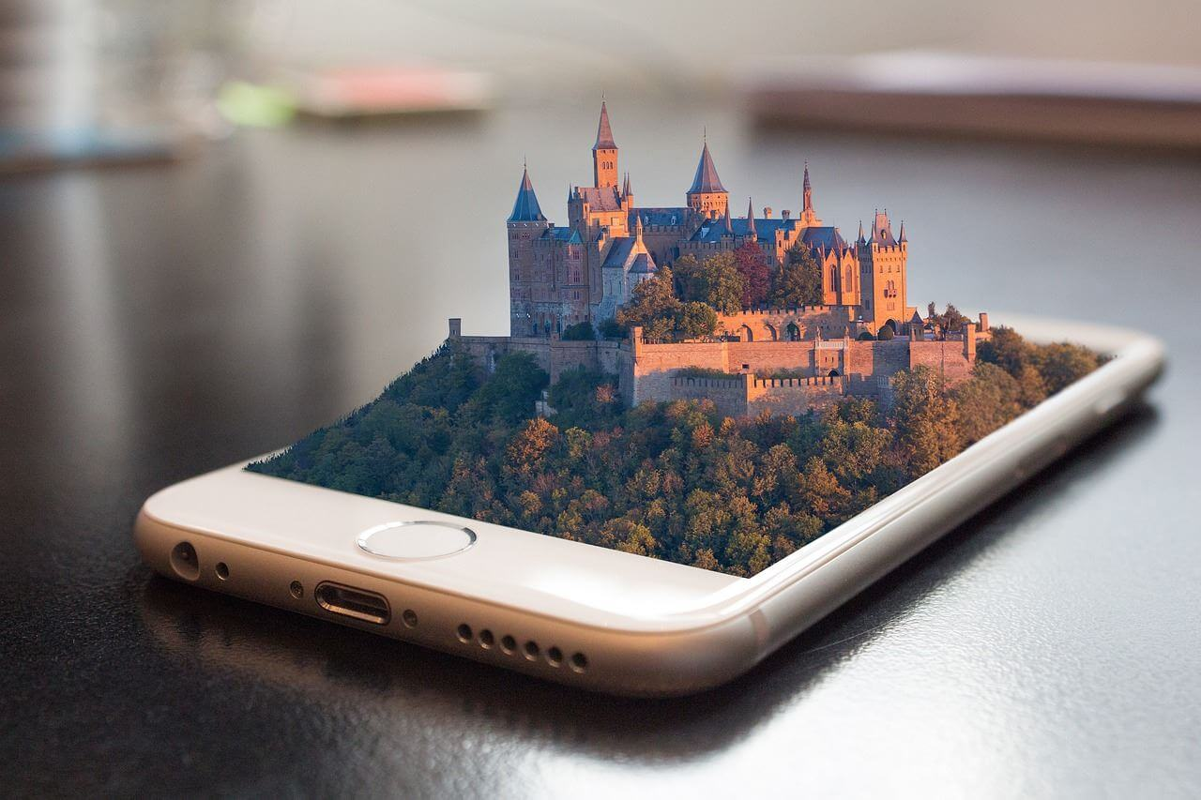
工作完成情况
print the presentation and make it into a film to be used in a wider field
标题文字添加
标题文字添加
The user can demonstrate on a projector or computer
The user can demonstrate on a projector or computer
标题文字添加
标题文字添加
The user can demonstrate on a projector or computer
The user can demonstrate on a projector or computer
标题文字添加
标题文字添加
The user can demonstrate on a projector or computer
The user can demonstrate on a projector or computer

Slide 15
工作完成情况
print the presentation and make it into a film to be used in a wider field
01
Vue.js
Node.js
01
PhpMyAdmin
The user can demonstrate on a projector or computer
The user can demonstrate on a projector or computer
The user can demonstrate on a projector or computer, or presentation and make it film to be used in a wider field
02
标题文字添加
02
标题文字添加
The user can demonstrate on a projector or computer
The user can demonstrate on a projector or computer
标题文字添加
03
标题文字添加
The user can demonstrate on a projector or computer, or presentation and make it film to be used in a wider field
03
标题文字添加
The user can demonstrate on a projector or computer
The user can demonstrate on a projector or computer

Slide 16




工作完成情况
print the presentation and make it into a film to be used in a wider field
标题文字添加
标题文字添加
The user can demonstrate on a projector or computer, or presentation and make it film to be used in a wider field
The user can demonstrate on a projector or computer, or presentation and make it film to be used in a wider field
标题文字添加
标题文字添加
The user can demonstrate on a projector or computer, or presentation and make it film to be used in a wider field
The user can demonstrate on a projector or computer, or presentation and make it film to be used in a wider field

Slide 17
PART 03
工作存在不足
The user can demonstrate on a projector or computer, or print the presentation and make it into a film to be used in a wider field

Slide 18
工作存在不足
print the presentation and make it into a film to be used in a wider field
标题文本预设
标题文字添加
The user can demonstrate on a projector or computer
标题文本预设
标题文字添加
The user can demonstrate on a projector or computer
标题文本预设
标题文字添加
The user can demonstrate on a computer
标题文本预设
标题文字添加
The user can demonstrate on a projector or computer

Slide 19
工作存在不足
print the presentation and make it into a film to be used in a wider field
文字添加
The user can demonstrate on a projector or computer, or presentation and make it film to be used in a wider field
文字添加
文字添加
The user can demonstrate on a projector or computer, or presentation and make it film to be used in a wider field
The user can demonstrate on a projector or computer, or presentation and make it film to be used in a wider field

Slide 20
工作存在不足
print the presentation and make it into a film to be used in a wider field
文字添加
文字添加
文字添加
文字添加
The user can demonstrate on a projector or computer, or presentation and make it film to be used in a wider field
The user can demonstrate on a projector or computer, or presentation and make it film to be used in a wider field
The user can demonstrate on a projector or computer, or presentation and make it film to be used in a wider field
The user can demonstrate on a projector or computer, or presentation and make it film to be used in a wider field

Slide 21

工作存在不足
print the presentation and make it into a film to be used in a wider field
标题文字添加
标题文字添加
The user can demonstrate on a projector or computer, or presentation and make it film to be used in a wider field
The user can demonstrate on a projector or computer, or presentation and make it film to be used in a wider field
标题文字添加
标题文字添加
The user can demonstrate on a projector or computer, or presentation and make it film to be used in a wider field
The user can demonstrate on a projector or computer, or presentation and make it film to be used in a wider field

Slide 22
工作存在不足
print the presentation and make it into a film to be used in a wider field
文字添加此处
The user can demonstrate on a projector or computer
文字添加此处
The user can demonstrate on a projector or computer
文字添加此处
The user can demonstrate on a projector or computer
文字添加此处
The user can demonstrate on a projector or computer
文字添加此处
The user can demonstrate on a projector or computer

Slide 23
PART 04
明年工作计划
The user can demonstrate on a projector or computer, or print the presentation and make it into a film to be used in a wider field

Slide 24
明年工作计划
print the presentation and make it into a film to be used in a wider field
40%
30%
85%
65%
35%
标题文字添加
标题文字添加
标题文字添加
标题文字添加
标题文字添加

Slide 25
明年工作计划
print the presentation and make it into a film to be used in a wider field
文字添加
文字添加
文字添加
The user can demonstrate on a projector or computer, or presentation and make it film to be used in a wider field
The user can demonstrate on a projector or computer, or presentation and make it film to be used in a wider field
The user can demonstrate on a projector or computer, or presentation and make it film to be used in a wider field

Slide 26
明年工作计划
print the presentation and make it into a film to be used in a wider field
标题文字添加
01
标题文字添加
02
The user can demonstrate on a projector or computer, or presentation and make it film to be used in a wider field
03
The user can demonstrate on a projector or computer, or presentation and make it film to be used in a wider field
04
标题文字添加
标题文字添加
The user can demonstrate on a projector or computer, or presentation and make it film to be used in a wider field
The user can demonstrate on a projector or computer, or presentation and make it film to be used in a wider field

Slide 27
明年工作计划
print the presentation and make it into a film to be used in a wider field
标题文字添加此处
标题文字添加此处
标题文字添加此处
标题文字添加此处
标题文字添加此处
标题文字添加此处
Jan
Feb
Mar
Apr
May
Jun
Jul
Aug
Sep
Oct
Nov
Dec
标题文字添加此处
The user can demonstrate on a projector or computer, or print the presentation and make it into a film to be used in a wider fieldThe user can demonstrate on a projector or computer, or print the to be used in a wider field

Slide 28
工作总结 / 工作计划 / 工作汇报
BUSINESS PLAN
感谢您的观看
The user can demonstrate on a projector or computer, or print the presentation and make it into a film to be used in a wider field
汇报人：优品PPT

